Slide 1
Atlas Updates Guide
The following presentation will provide before and after images to show how different aspects of the Atlas Find a Class tool will be updated beginning January 22, 2025.

Slide 2
Map Changes

Slide 3
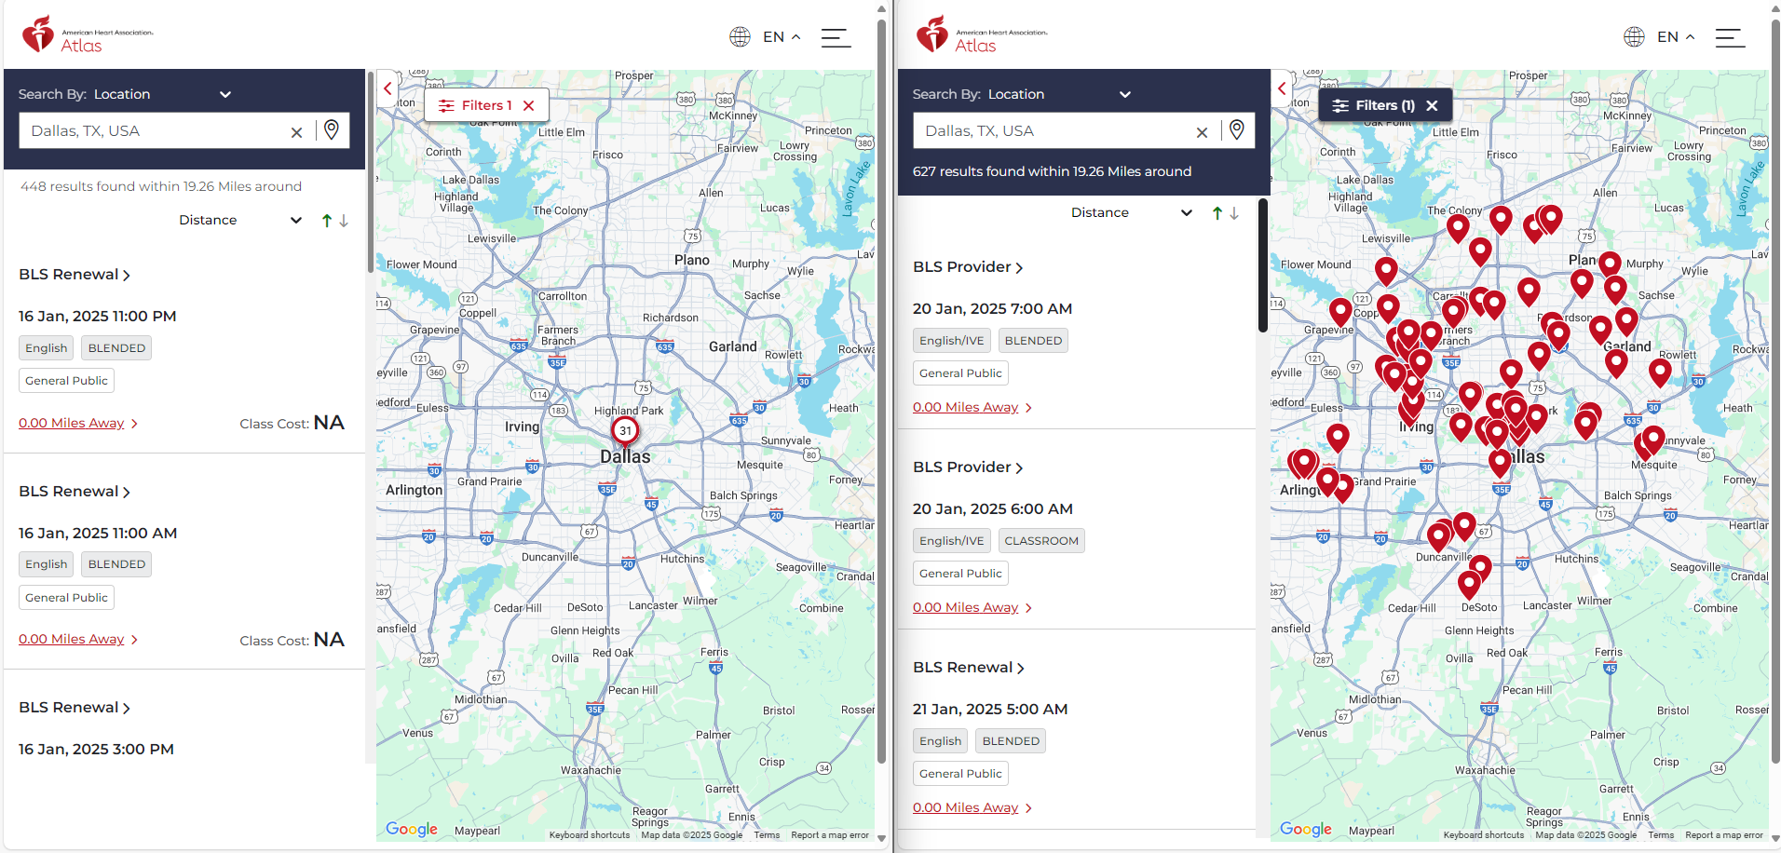
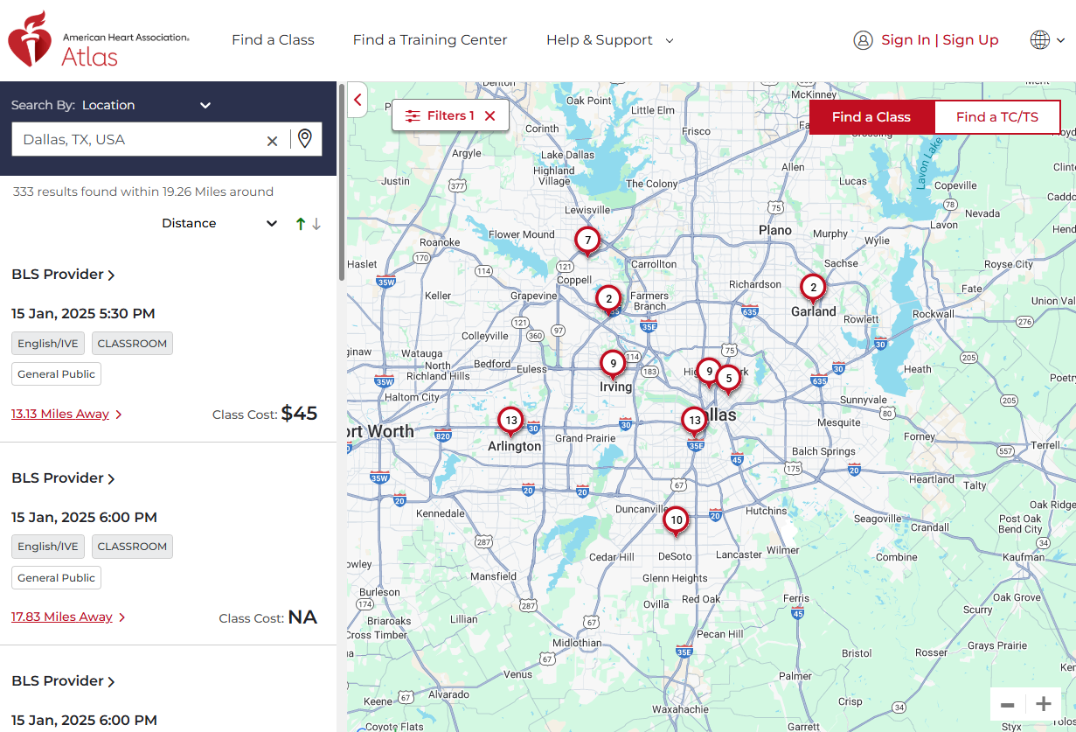
Instead of pins being loaded onto the map as the student scrolls through class listings, the pins will continuously load until all locations within the searched location are populated
A “Loading Class Locations” message will appear on the map until all locations are loaded.
Before
After

Slide 4
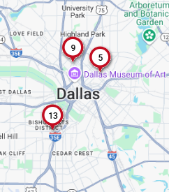
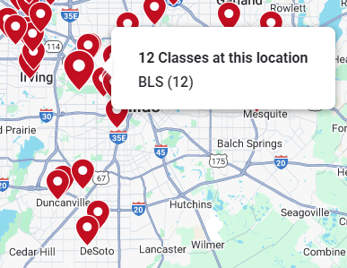
The map marker/pin style has been updated-no longer showing the number of classes at the location. When you hover over the pin a pop-up window will appear with more information about that location.
Before
After

Slide 5
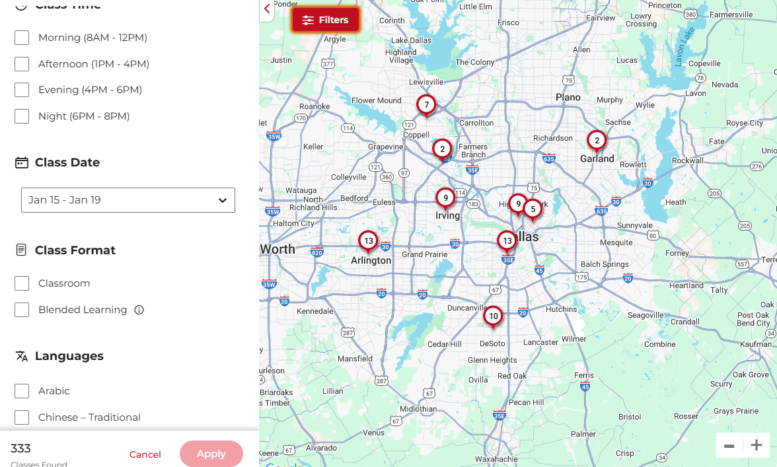
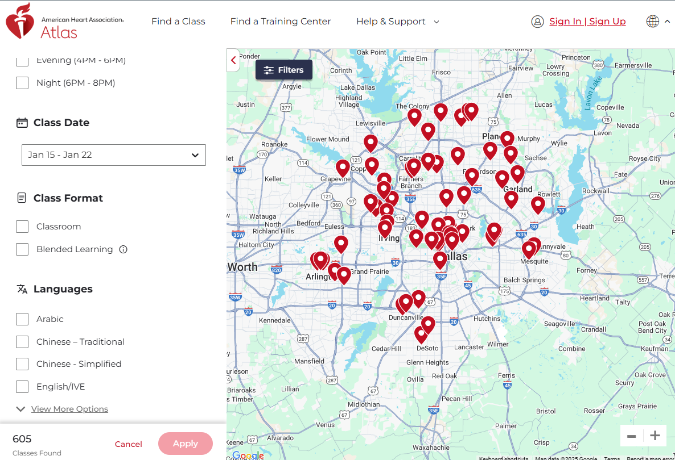
Default date range is being updated from “This Week” (today through Sunday) to “Next 7 days” (today + next 7 days)
Before
After

Slide 6
Class Listing Changes

Slide 7
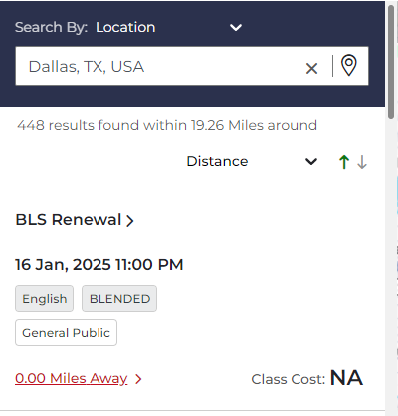
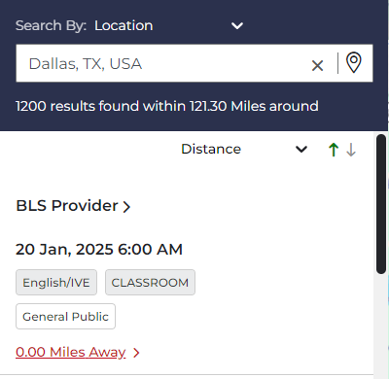
Class cost no longer displays
Before
After
Location
Location

Slide 8
A more prominent scrollbar has been added to class listings
Before
After

Slide 9
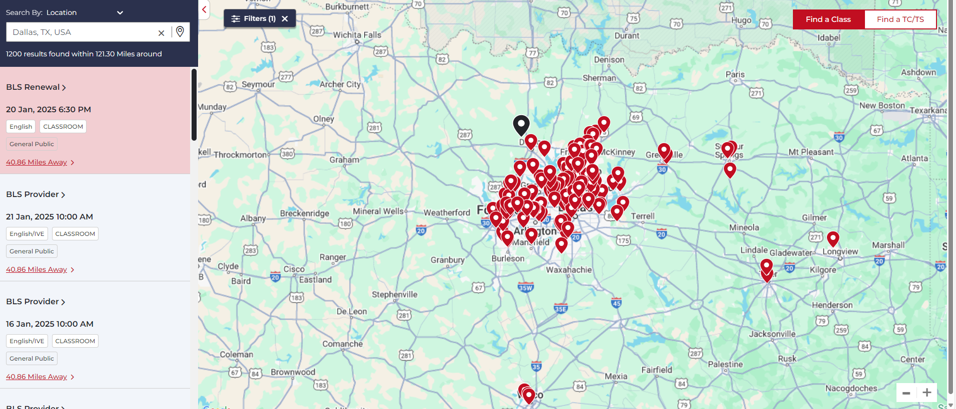
When you select a location pin, the associated classes are identified in the class listing with a light grey highlight. The first class associated with the location is highlighted in red.

Slide 10
Expanded Class Card

Slide 11
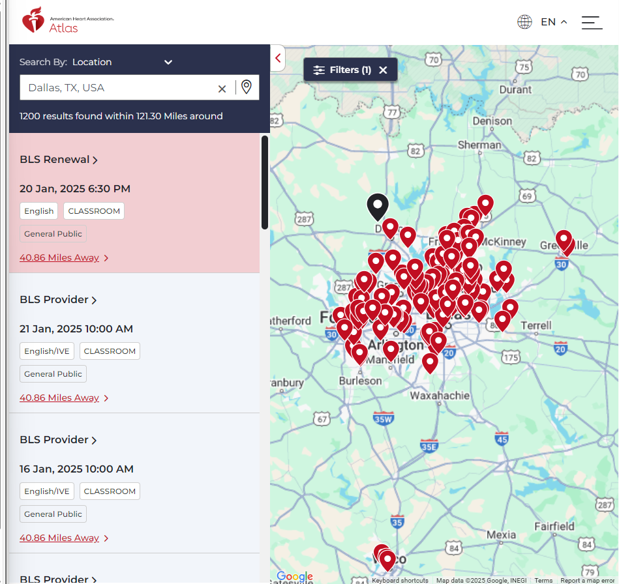
Class cost no longer displays in class listing.
Before
After

Slide 12
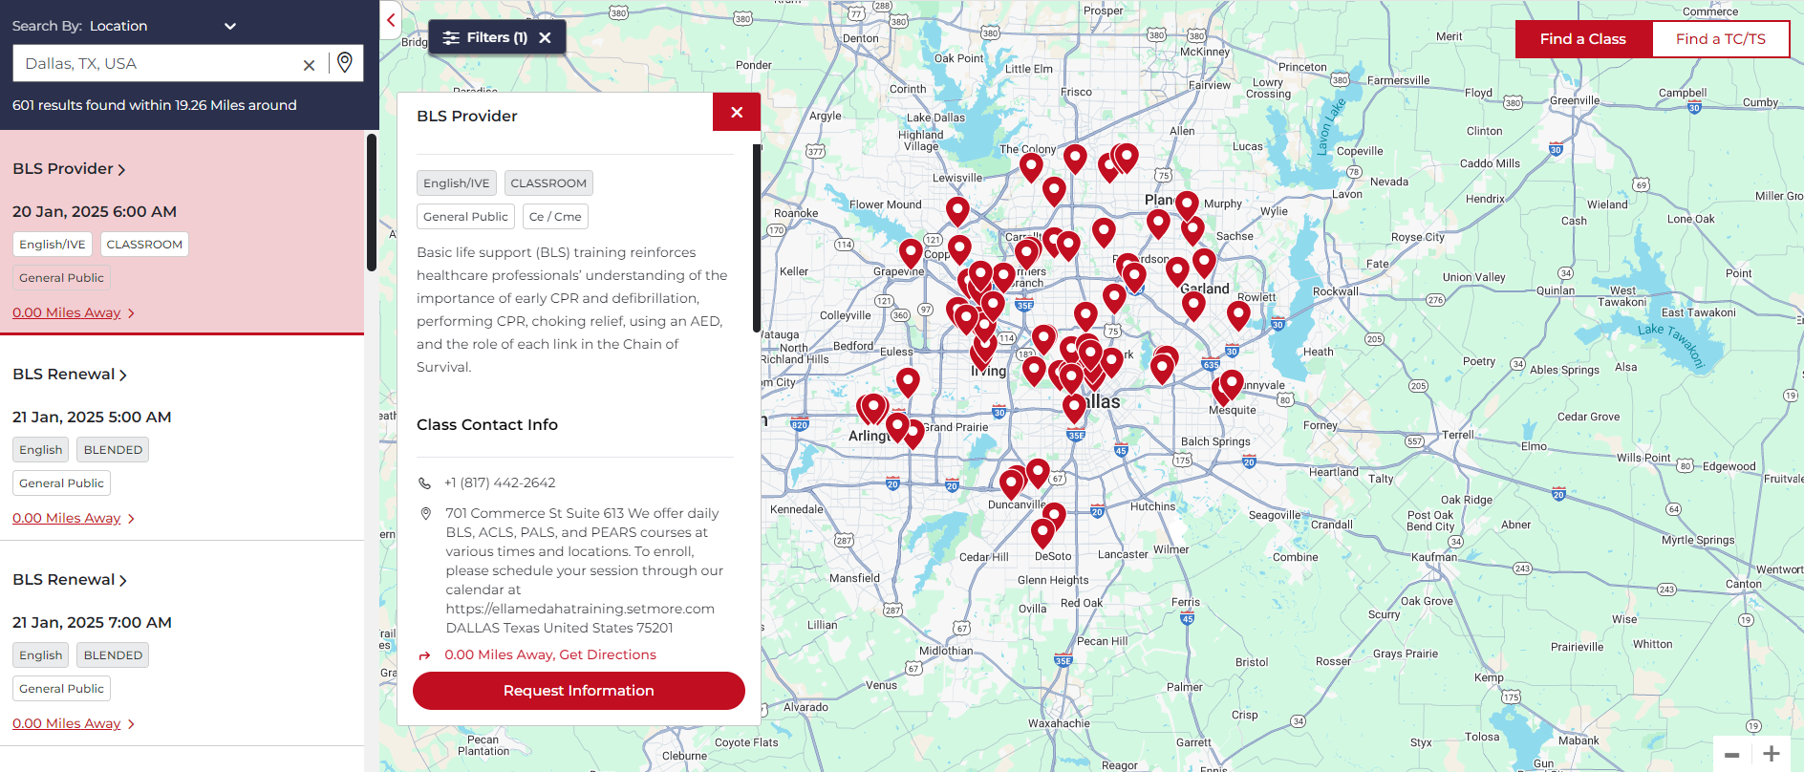
The expanded class card will display when the class listing is selected.

Slide 13
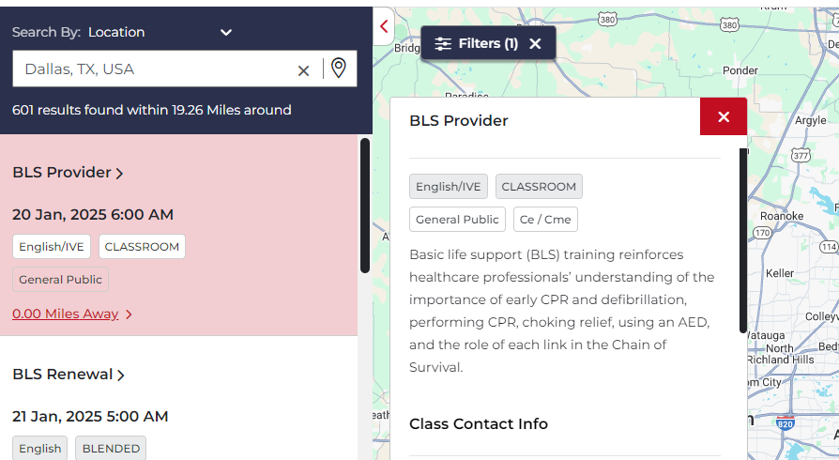
Scroll bars have been added to ensure the user scrolls through relevant information

Slide 14
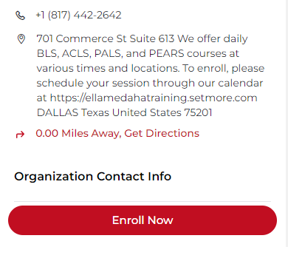
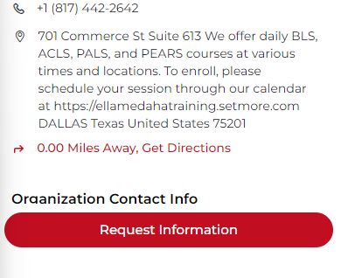
The “Enroll Now” button text has changed to guide the User to “Request Information”
There are no changes to the user flow or action of this button, only the text has been updated in order to better accommodate different enrollment models
Before
After
Address and Additional Class Information
Address and Additional Class Information

Slide 15
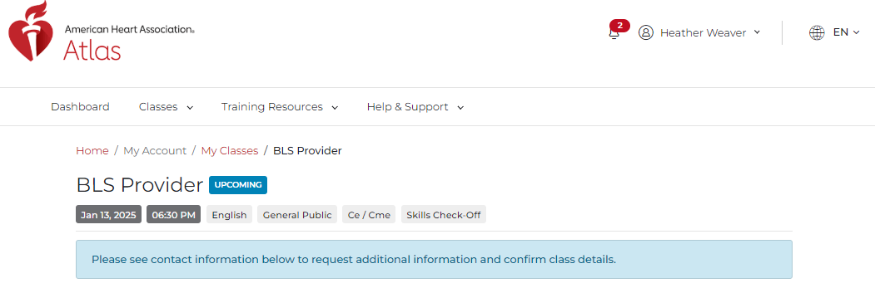
After selecting “Request Information,” students will see a new note that has been added to the page encouraging them to contact the TC for further action/information.
Banner says “Please see contact information below to request additional information and confirm class details.”

